Slide 1


Green Pace
Security Policy Presentation
Developer: Jaelyn Sloan
Notes:
Hello, welcome to my security policy presentation for Green Pace.

Slide 2

OVERVIEW: DEFENSE IN DEPTH
This security policy was put in place to ensure that every layer of an organization is secure. The policy uses Defense in Depth (DID) to implement multiple different defense strategies to decrease the risk of an attacker being able to access a vulnerability. If an attacker gets through one layer, there will be another layer to stop them. This method reduces the consequences of an attacker breaching the system.
Notes:
To begin, I would like to explain Defense in Depth. This policy is based on defense in depth, which is a strategy to create a layered effect using multiple different defense strategies to decrease the risk of a data breach.

Slide 3
THREATS MATRIX
Likely Risk is more likely to occur STD-INT32-C STD-MSC52-CPP STD-STR02-C STD-STR50-CPP STD-MEM52-CPP STD-ERR51-CPP STD-CTR51-CPP | Priority High risk/Threat needs attention STD-STR50-CPP STD-STR02-C STD-MEM52-CPP STD-INT32-C STD-MSC52-CPP
Low priority Risk has a low chance of a threat STD-DCL55-CPP STD-ERR51-CPP STD-FIO50-CPP STD-DCL52-CPP STD-CTR51-CPP | Unlikely Risk unlikely to occur STD-DCL55-CPP STD-FIO50-CPP STD-DCL52-CPP
Notes:
This threats matrix shows where each coding standard that I have identified fits in these four categories. Likely means that the risk is likely to occur. Priority means that this risk needs to be dealt with ASAP because it can cause major problems. Low priority means that these things can wait, because they are not as much of a risk. Unlikely means that this risk is unlikely to occur.

Slide 4
10 CORE SECURITY PRINCIPLES
Validate Input Data
STD-INT32-C
STD-STR50-CPP
STD-MEM52-CPP
STD-FIO56-CPP
STD-DLC52-CPP
STD-CTR51-CPP
Heed Compiler Warnings
STD-INT32-C
STD-STR50-CPP
Architect and Design for Security Policies
STD-MSC52-CPP
STD-MEM52-CPP
STD-ERR51-CPP
Keep It Simple
STD-DLC52-CPP
Default Deny
STD-STR02-C
Adhere to the Principle of Least Privilege
Sanitize Data Sent to Other Systems
STD-STR02-C
STD-DCL55-CPP
Practice Defense in Depth
Use Effective Quality Assurance Techniques
STD-INT32-C
STD-STR50-CPP
Adopt a Secure Coding Standard
STD-MSC52-CPP
STD-CTR51-CPP
Notes:
These are the 10 core security principles, and I have also listed where the coding standards fit in the principles. The principles are: validate input data, heed compiler warnings, architect and design for security policies, keep it simple, default deny, adhere to the principle of leash privilege, sanitize data sent to other systems, practice defense in depth, use effective quality assurance techniques, and finally, adopt a secure coding standard.

Slide 5
CODING STANDARDS
Data Type (STD-INT32-C) – Ensure that operations on signed integers do not result in overflow
Data Value (STD-MSC52-CPP) – Value returning functions must return a value from all exit paths
String Correctness (STD-STR50-CPP) – Guarantee that storage for strings has sufficient space for character data and the null terminator
SQL Injection (STD-STR02-C) – Sanitize data passed to complex subsystems
Memory protection (STD-MEM52-CPP) – Detect and handle memory allocation errors
Assertions (STD-DCL55-CPP) – Avoid information leakage when passing a class object across a trust boundary
Exceptions (STD-ERR51-CPP) – Handle all exceptions
Input/Output (STD-FIO50-CPP) – Do not alternatively input and output from a file stream without an intervening positioning call
Declaration (STD-DLC52-CPP) – Never qualify a reference type with a const or volatile
Containers (STD-CTR51-CPP) – Use valid references, pointers, and iterators to reference elements of a container
Notes:
These are the 10 coding standards that I have identified. These standards are: data type, data value, string correctness, SQL injection, memory protection, assertions, exceptions, input/output, declaration, and containers.

Slide 6
ENCRYPTION POLICIES
Encryption in Rest – Encryption at rest is used to protect data that is stored on a physical storage device, such as an SSD. By encrypting data on the disk, an attacker will not be able to view the data unless authorized to do so.
Encryption at Flight – Encryption at flight occurs when data is encrypted while it is in the process of being transmitted through a network. This is most important for companies that use the open internet to transmit data. This prevents an attacker from intercepting to data and being able to view it.
Encryption in Use - Encryption in use ensures that all sensitive data is always protected, regardless of use or location of data.
Notes:
These three encryption policies: encryption at rest, encryption at flight, and encryption in use, are extremely important for a developer to understand. Please read over the definitions.

Slide 7
TRIPLE-A POLICIES
Authentication – Authentication only allows verified users to access data. This is used for most databases so that users can only access the data if they have been granted permission. A user will have to have a granted login to access a database or they will have to create a new account if allowed.
Authorization – Users are given specific permissions depending on their access level. Depending on access level, some users may only be able to view data, while others may be able to modify data within a database.
Accounting – It is beneficial to monitor user actions within the database. Accounting allows for tracking of things such as files that are accessed by users and any changes they made in the database.
Notes:
The triple-a policy is a framework used to control who is permitted to use network resources, what they are authorized to do, and capture the actions performed while accessing the network

Slide 8
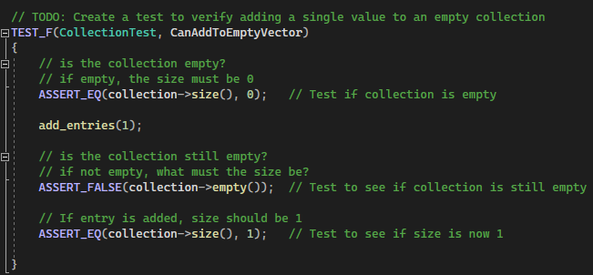
Unit Testing: CanAddToEmptyVector
This unit test checks to ensure functionality of adding a single value to an empty collection. This is a positive test.
Unit Test Code
Result
Notes:
Here is an example of a positive unit test which check to ensure functionality of adding a single value to an empty collection.

Slide 9
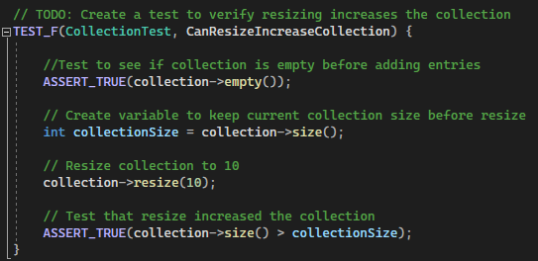
Unit Testing: CanResizeIncreaseCollection
This unit test checks that resizing the vector can increase the collection. This is a positive test.
Unit Test Code
Result
Notes:
This is another positive unit test which checks that resizing the vector can increase the collection as expected.

Slide 10
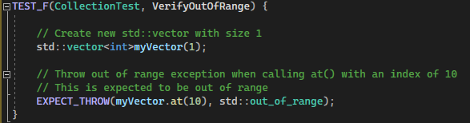
Unit Testing: VerifyOutOfRange
This unit test checks that the std:out_of_range exception is thrown when calling at() with an index out of bounds. This is a negative test.
Unit Test Code
Result
Notes:
This is an example of a negative unit test. This test checks that the function called will return an error message as expected when the index is out of bounds

Slide 11
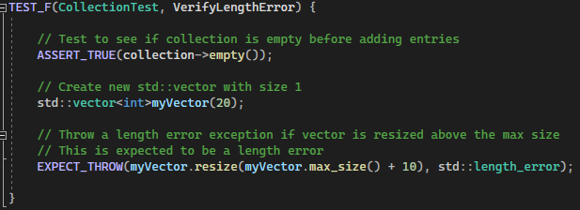
Unit Testing: VerifyLengthError
This unit test checks that an error will be thrown if the vector is resized above the max size.
Unit Test Code
Result
Notes:
This is another negative unit test which is expected to throw an error when the vector is resized above the max size.

Slide 12

AUTOMATION SUMMARY
Notes:
This automation summary provides a visual for the DevSecOps pipeline. This shows what the process of development should look like, from pre-production to production.

Slide 13
TOOLS
The DevSecOps pipeline is a strategy used by Green Pace to implement DID and secure methods. This strategy begins with a pre-production phase consisting of planning, designing, building secure code, and verifying and testing the system. Then, the production phase consists of maintaining the program, responding to any threats, monitoring and detecting threats, and transitioning and performing health checks.
Lightweight Directory Access Protocol (LDAP) can be used to query user information rapidly. LDAP controls the access and maintenance of static data, such as usernames, passwords, email addresses, and other sensitive.
Active directory (AD) is used to store sensitive information and is a secure way to control access to network resources.
Notes:
Using the DevSecOps pipeline which was shown on the previous page, will ensure that the developer is implementing security in every aspect of the development process. Extra tools which could be implemented are LDAP or AD, which are used to store and access secure information.

Slide 14
RISKS AND BENEFITS
The risk of waiting to implement security policies is much greater than the risk if you begin implementing policies early on. By waiting, you risk time, money, and reputation if the program is completed and ends up having many vulnerabilities. It would be detrimental to complete an entire program and have to begin all over with, or to expose your client’s secure data and risk your company’s reputation.
The solution to this is to begin implementing security from the very start. By doing this, there is a much higher level of security throughout the program, and there is a much lower risk of a vulnerability.
Notes:
The risk of not implementing security until the end will result in a very high chance of vulnerabilities in the program. This risks a lot of time, money, and your reputation, as well as the company who you are developing the program for’s reputation. It is wise to begin implementing security from the very start.

Slide 15
RECOMMENDATIONS
Always communicate effectively with fellow developers.
Avoid adding any “backdoors” in the system.
Have a plan for when a breach does occur.
Stay consistent with coding standards.
Automate any routine tasks.
Notes:
Some of the main recommendations which are not specifically listed in this security policy are:

Slide 16
CONCLUSIONS
Security should be implemented from the very beginning of the development process, beginning at the planning phase.
Always use DiD when developing a program. Create multiple layers of security to prevent an attacker from breaching the system.
Use the Triple-A architecture to aide in detecting a data breach.
Notes:
In conclusion, implement security from the very beginning. Always use DiD to create the most secure version of your program possible. And finally, use the triple a framework to aide in detecting a data breach.

Slide 17
REFERENCES
Are you following the top 10 software security best practices? Application Security Blog. (2021, July 1). Retrieved February 16, 2023, from https://www.synopsys.com/blogs/software-security/top-10-software-security-best-practices/
30 tips for software developers to enhance software security - codesigningstore. Code Signing Store. (2022, April 6). Retrieved February 16, 2023, from https://codesigningstore.com/tips-for-software-developers-to-enhance-software-security

